Slide 1




Brent Holiday Activities and Food Programme

Slide 2
Overview of Holiday Activities and Food (HAF) Programme
The programme is funded by the Department for Education
Provides free access to activities and meals during the school holidays
The programme is primarily for children on benefit-related free school meals
Holiday Duration
Minimum of 4 days of HAF activities during Easter and Christmas holidays
16 days of HAF activities offered during summer holidays
The programme does not operate during half term holidays
Programme Components
Diverse range of engaging, physical, and enriching activities
Nutritious meals
Education on healthy eating, lifestyles, and food preparation
Support and referrals for parents, caregivers, and families

Slide 3
Eligibility
Children and young people must meet all the following criteria:
School-aged children from Reception to Year 11 (aged 4-16)
Be in receipt of benefit-related free school meals (not including the universal free school meals)
A resident of Brent or attending a Brent school.
15% of funding can be used for those deemed vulnerable by the Local Authority including:
  Looked after children
  Refugees
  Young carers
  SEND/ EHCP
  Low-income families
  Risk of exclusion/ low attendance
  Risk of antisocial behaviour

Slide 4

Accessing the HAF Programme
HAF providers can be found on the Brent HAF website (Holiday Activities and Food Programme | Brent Council)
This information is updated prior to the Easter, summer and Christmas school holidays
The website offers details about our providers including venues, age groups and how to book.
Please note that provisions do not offer transportation services.
Proving eligibility
Free school meals: Supermarket vouchers, e-codes, letter from the local authority/ school verifying FSM status.
Referral through a social worker, teacher or other working professional.
Contact the Brent HAF Team and we can provide proof of eligibility
HAF@Brent.gov.uk

Slide 5
Brent HAF Programme
Overview of HAF 2024:​
We worked with 40 providers to deliver 4,384 HAF places across the Easter, summer and Christmas school holidays.
663 of these were SEND places.
Activities included mixture of different sports, junk modelling, boxing, horse riding, wall climbing, gardening, cooking, podcasting, public speaking workshops, drama and music workshops as well as various trips.
Mental Health and Emotional Wellbeing sessions and first aid training

Slide 6
Case Study
Child X's Easter 2025 HAF Experience
Child X, a Year 2 pupil, was referred to the Easter HAF camp by their school due to behavioural challenges rooted in difficulties with emotional expression and understanding. Child X has previously been in care, and their early experiences have made it harder for them to trust adults and connect with peers.
At the start of camp, child X expressed anxiety about social interaction, saying, “But I don’t know how to make friends.” The provider focused on building a safe, supportive environment where child X could explore their emotions and build relationships at their pace. Facilitators worked to gain their trust, using play, structured group activities, and one-to-one moments to support emotional development.
The provider also established a strong and open line of communication with mum, which helped reinforce their sense of stability and belonging. By the end of the four-day programme, a clear shift was seen. They were calmer, more able to express how they were feeling, and had formed genuine friendships. Several children referred to child X as their friend, a milestone that was both meaningful and affirming for them.
Child X’s final words to staff “I never want this camp to end” reflected the progress they made and the sense of connection they found during their time with them.

Slide 7
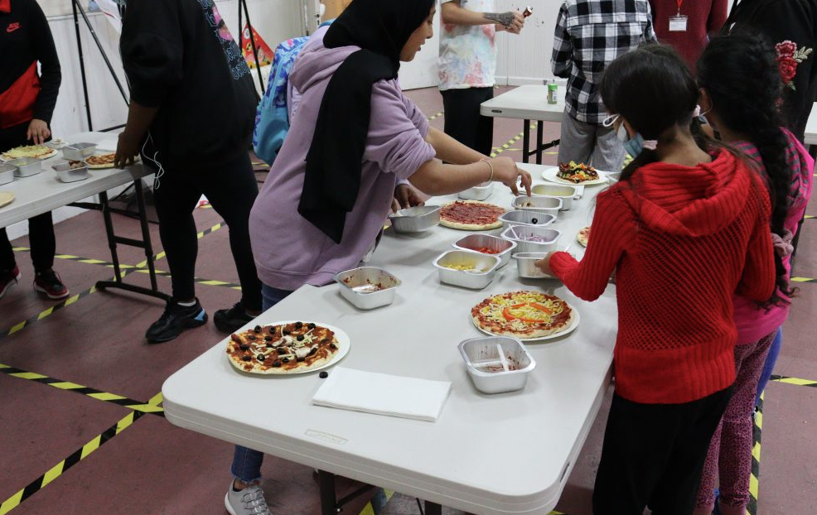
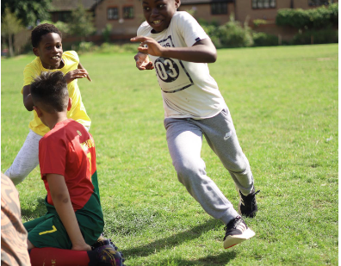
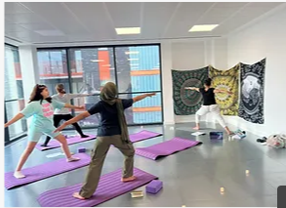
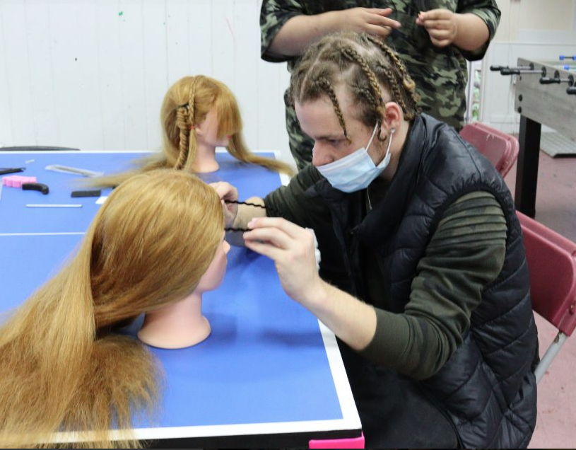
HAF Summer Offer

Slide 8
HAF Summer Offer
For the upcoming summer programme, we have commissioned 52 Providers including 2 SEND specialist providers
Activities include:
Sports; football, skateboarding, tennis, cricket and more!
Arts and Crafts
Boat trips
Water Sports
Drama Workshops
Cooking classes
Trips such as Museums and Welsh Harp
Some partner organisations will also provide free sessions such as Mental Health Workshops with the NHS and BeeZees Families Community Health.

Slide 9

Contact Details
For any HAF enquiries:
Please contact: haf@brent.gov.uk
Alternatively, you can contact ourselves:
Alexandra Eyre: Alexandra.Eyre@brent.gov.uk
or
Julia Nyako: Julia.Nyako@brent.gov.uk

Slide 10

Any Questions?

